Slide 1
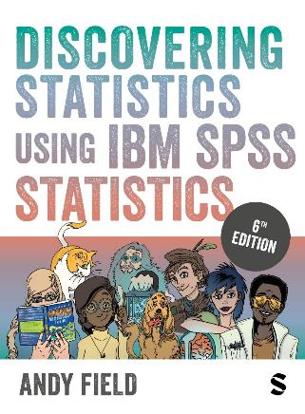
Discovering Statistics Using IBM SPSS Statistics
Andy Field
This deck incorporates accessible elements, such as standardized content reading order, and image description for all figures presented.

Slide 2
Chapter 10
Comparing Two Means

Slide 3
Aims
t-tests
  Dependent (paired-samples, matched-pairs)
  Independent
Rationale for the tests
  Assumptions
Interpretation
Reporting results
Calculating an effect size

Slide 4
Experiments (1)
The simplest form of experiment that can be done is one with only one independent variable (IV) that is manipulated in only two ways, and only one outcome is measured.
Usually the manipulation of the IV involves having an experimental condition and a control condition.

Slide 5
Experiments (2)
Example:
  E.g., Is the movie Scream 2 scarier than the original Scream?
  Independent variable?
  How to measure?
    We could measure heart rates (which indicate anxiety) during both films and compare them.
How to analyze? a t-test.

Slide 6
t-test
Dependent t-test
  Compares two means based on related data.
  E.g., Data from the same people measured at different times.
  Data from ‘matched’ samples.
Independent t-test
  Compares two means based on independent data
  E.g. data from different groups of people.

Slide 7
Cloaks of Invisibility (1)
Are invisible people mischievous?
  24 participants
Manipulation
  Placed participants in an enclosed community riddled with hidden cameras.
  12 participants were given an invisibility cloak.
  12 participants were not given an invisibility cloak.
Outcome
  measured how many mischievous acts participants performed in a week.

Slide 8
Cloaks of Invisibility (2)
Hypotheses:
  H₀: Invisible and visible people will conduct the same number of mischievous acts
    M₁ = M₂
  H₁: Invisible people will conduct more mischievous acts
    M₁ > M₂

Slide 9
Cloaks of Invisibility (3)
Participant | Cloak | Mischievous Acts
1 | Yes | 10
2 | Yes | 7
3 | Yes | 9
4 | Yes | 12
5 | Yes | 5
6 | Yes | 8
7 | Yes | 11
8 | Yes | 6
9 | Yes | 14
10 | Yes | 7
11 | Yes | 9
12 | Yes | 8
13 | No | 3
14 | No | 2
15 | No | 5
16 | No | 6
17 | No | 4
18 | No | 7
19 | No | 3
20 | No | 5
21 | No | 2
22 | No | 6
23 | No | 4
24 | No | 5
Notes:
IV? DV? Groups? Independent or dependent?

Slide 10
Cloaks of Invisibility (4)
Summary statistics
Group | N | Mean | S
Cloak = Yes | 12 | 8.4 | 2.7
Cloak = No | 12 | 4.3 | 1.6
Notes:
IV? DV? Groups? Independent or dependent?

Slide 11
Rational for the t-test (1 of 3)
Two samples are collected and the means calculated.
  These means might differ by either a little or a lot.
If the samples come from the same population, large differences between samples should be rare
Under the null hypothesis, we expect means from two random samples to be very similar (H₀)
A large mean difference would likely be due to our manipulation (H₁)

Slide 12
Rational for the t-test (2 of 3)
We compare the difference between the sample means that we collected to the difference we would expect If there were no effect.
If observed > (or <) expected than we would expect based on the standard error, then one of two things has happened:
  There is no effect but sample means from our population fluctuate a lot and we happen to have collected two samples that produce very different means.
  This difference indicates a genuine difference between the samples. In other words, the null hypothesis is unlikely.

Slide 13
Rational for the t-test (3 of 3)
The larger the observed difference between the sample means (relative to the standard error), the more likely it is that the two sample means differ because of the different testing conditions imposed on each sample.
AKA the more confidence we have that our manipulation produced the difference

Slide 14
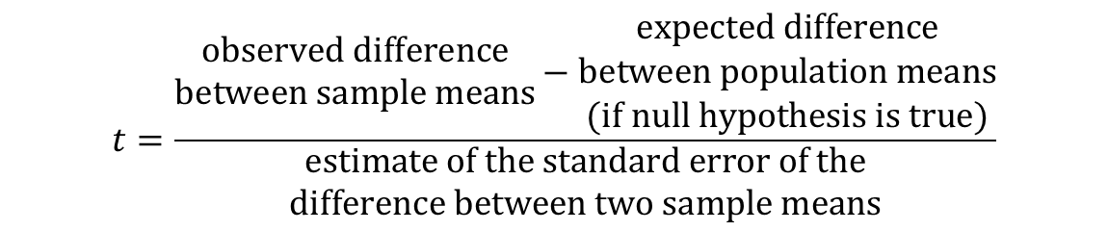
Rationale of the t-test
$$t=\frac{\begin{matrix}\text{observed} \text{difference} \\ \text{between} \text{sample} \text{means}\end{matrix}−\begin{matrix}\text{expected} \text{difference} \\ \text{between} \text{population} \text{means} \\ \text{(}\text{if} \text{null} \text{hypothesis} \text{is} \text{true}\text{)}\end{matrix}}{\begin{matrix}\text{estimate} \text{of} \text{the} \text{standard} \text{error} \text{of} \text{the} \\ \text{difference} \text{between} \text{two} \text{sample} \text{means}\end{matrix}}$$

Slide 15
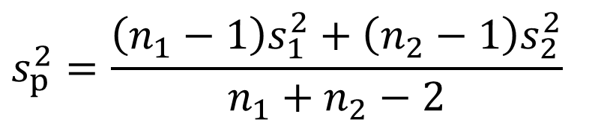
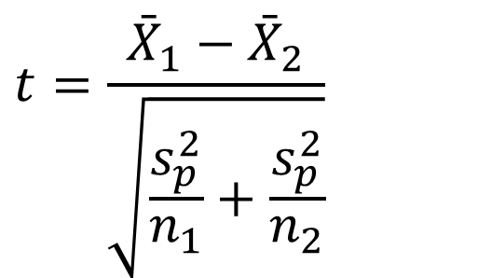
The Independent t-test
$$t=\frac{{\bar{X}}_{1}−{\bar{X}}_{2}}{\sqrt{\frac{s_{p}^{2}}{n_{1}}+\frac{s_{p}^{2}}{n_{2}}}}$$
$$s_{p}^{2}=\frac{\left(n_{1}−1\right)s_{1}^{2}+\left(n_{2}−1\right)s_{2}^{2}}{n_{1}+n_{2}−2}$$

Slide 16
Cloaks of Invisibility (4)
Summary statistics
Group | N | Mean | S
Cloak = Yes | 12 | 8.4 | 2.7
Cloak = No | 12 | 4.3 | 1.6
Notes:
IV? DV? Groups? Independent or dependent?

Slide 17
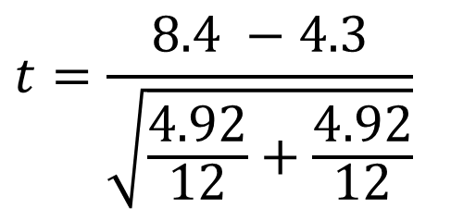
Cloaks of Invisibility (5)
$$t=\frac{8.4 −4.3}{\sqrt{\frac{4.92}{12}+\frac{4.92}{12}}}$$
Notes:
IV? DV? Groups? Independent or dependent?

Slide 18
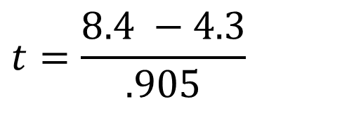
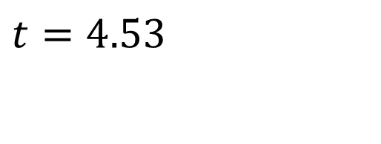
Cloaks of Invisibility (6)
$$t=\frac{8.4 −4.3}{.905}$$
Standard Error (SE)
$$t=4.53$$
Notes:
IV? DV? Groups? Independent or dependent?

Slide 19
t-tests and significance (1)
What exactly is t?
  t is a test statistic
  A test statistic is a single numerical value calculated from your sample data during hypothesis testing
  Summarizes how much your observed data deviates from what you'd expect under the null hypothesis.
  The larger (or more extreme) this value, the stronger the evidence against the null hypothesis.

Slide 20
t-tests and significance (2)
Test statistics are normed
The probability of obtaining a specific t-value can be determined using the t-distribution
Things you need:
  Alpha (significance level)
  Number of tails (usually 2)
  DF (degrees of freedom – n – 2 for an independent t-test)

Slide 21
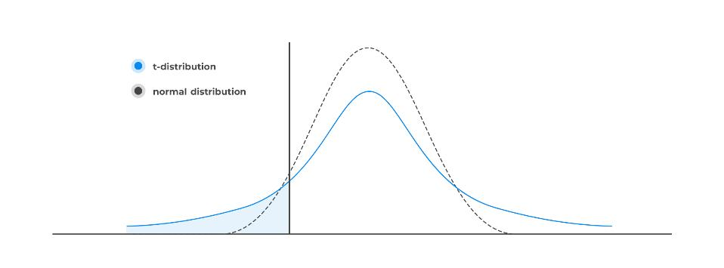
t-distribution

Slide 22
t-tests and significance (3)
t-table (use to look up the critical t-test statistic)
  Compare your t to critical t-value (in table). If larger, significant difference!
t-probability table (used to find probability of your t-value)
Values you need:
  Calculated t
  Alpha (significance level)
  Number of tails (usually 2)
  DF (degrees of freedom – n – 2 for an independent t-test)

Slide 23
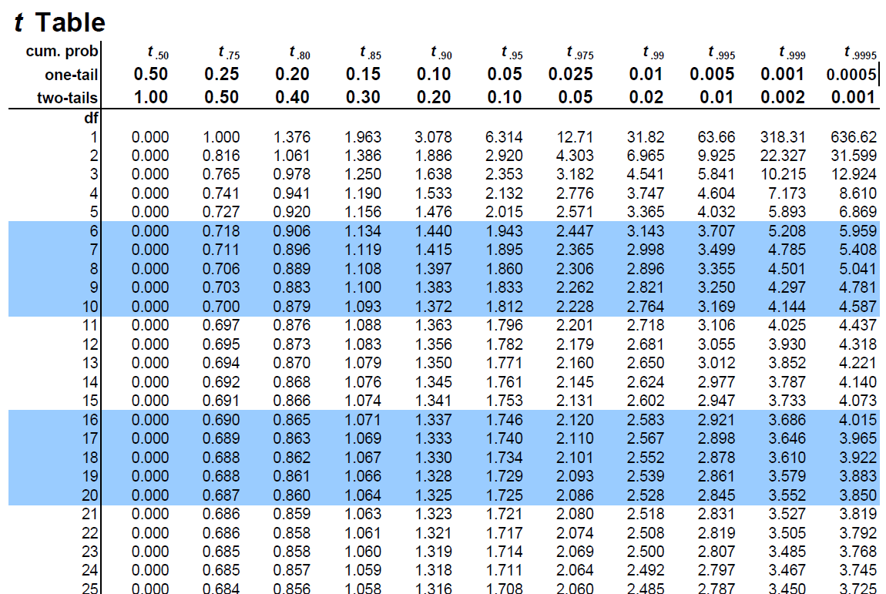
t-table

Slide 24
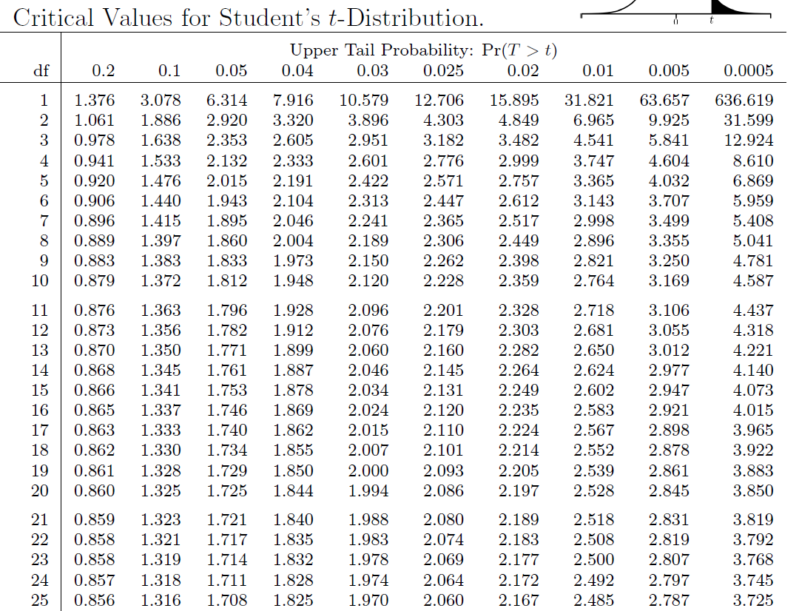
t-probability table
p < .001

Slide 25
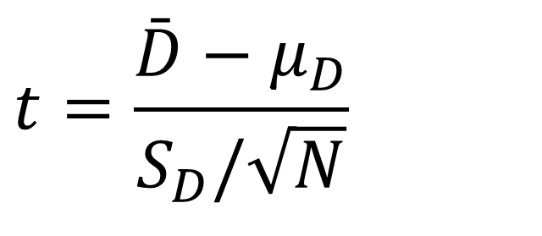
The Dependent t-test
Purpose: Compares the means of two related groups to determine if there is a statistically significant difference between them
When to Use?
The same subjects are measured under two conditions or at two different times.
Common in pre-test/post-test designs or within-subject experiments.
$$t=\frac{\bar{D}−μ_{D}}{S_{D}/\sqrt{N}}$$

Slide 26
Example (1)
A manufacturer wants to test if a new keyboard reduces typing time. Six students typed a term paper on both their regular keyboard (Condition X) and the new keyboard (Condition Y).
Independent variable?
Dependent variable?
Null (H₀): The average difference is zero (μ₍d₎ = 0)—i.e., no effect.
Alternative (H₁): The average difference is not zero (μ₍d₎ ≠ 0).

Slide 27
Example (2)
Student | Regular (X) | New Keyboard (Y) | Difference (d = X−Y)
A | 54 | 52 | 2
B | 63 | 61 | 2
C | 47 | 48 | –1
D | 61 | 58 | 3
E | 52 | 51 | 1
F | 59 | 55 | 4

Slide 28
Example (3)
Condition | N | Mean (min) | Std. Dev. (min) | Std. Error (min)
Regular Keyboard (X) | 6 | 56.00 | 6.40 | 2.61
New Keyboard (Y) | 6 | 54.17 | 4.75 | 1.94
Difference (X−Y) | 6 | 1.83 | 1.72 | 0.70

Slide 29
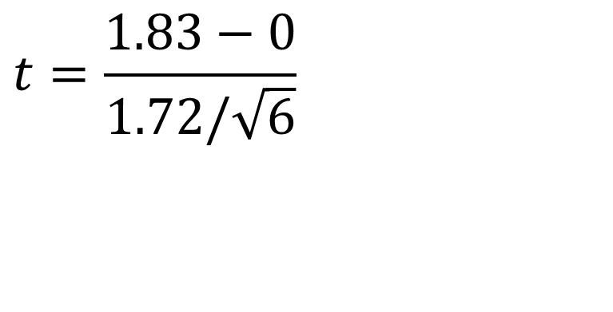
Example (4)
Mean diff
$$t=\frac{1.83−0}{1.72/\sqrt{6}}$$
Population mean diff (why 0?)
S diff
Sample Size
Notes:
The null hypothesis of the paired t‑test assumes no true difference between the two conditions.

Slide 30
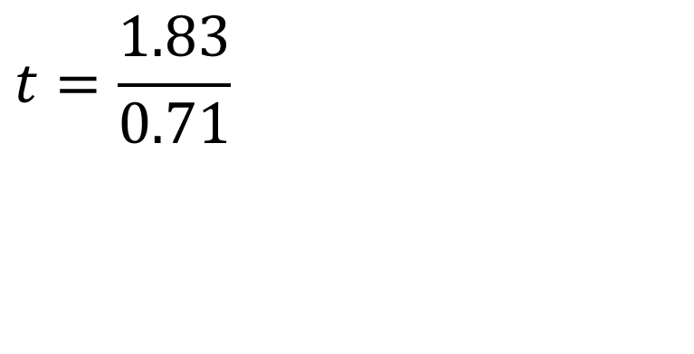
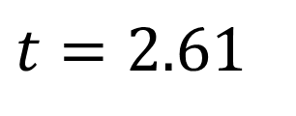
Example (5)
$$t=\frac{1.83}{0.71}$$
$$t=2.61$$
Is this difference significant? What is the critical t? What is the p-value?
Notes:
The null hypothesis of the paired t‑test assumes no true difference between the two conditions.

Slide 31
Assumptions of the t-test (1 of 2)
Both the independent t-test and the dependent t-test are parametric tests based on the normal distribution. Therefore, they assume:
  The sampling distribution is normally distributed. In the dependent t­-test this means that the sampling distribution of the differences between scores should be normal, not the scores themselves.
  Data are measured at least at the interval level.

Slide 32
Assumptions of the t-test (2 of 2)
The independent t-test, because it is used to test different groups of people, also assumes:
  Variances in these populations are roughly equal (homogeneity of variance).
  Scores in different treatment conditions are independent (because they come from different people).

Slide 33
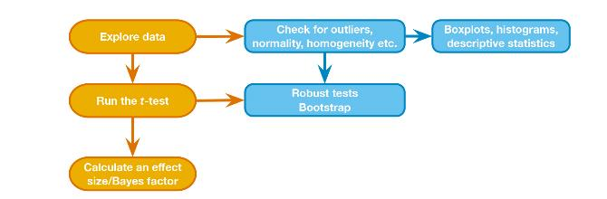
t-test General Process

Slide 34
Effect Sizes (1)
Effect sizes quantify the magnitude of a difference or relationship between groups or variables.
Provides context to statistical significance, answering the question: "How large is the observed effect?"
Complement p-values! While a p-value indicates whether an effect exists, the effect size tells us how substantial that effect is.

Slide 35
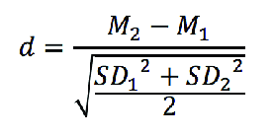
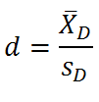
Effect Sizes (2)
Common effect size for t-tests: Cohen’s d
  Measures the standardized difference between two means.
Independent samples
Dependent Samples

Slide 36
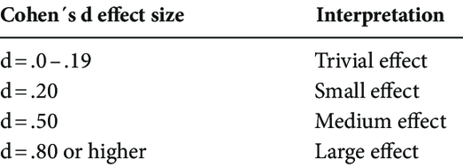
Effect Sizes (3)

Slide 37
Reporting the t-test
On average, participants given a cloak of invisibility engaged in more acts of mischief (M = 8.4, SD = 2.7), than those not given a cloak (M = 4.3, SD = 1.6). This difference was significant, t(22) = 4.53, p < .001 and represented a large-sized effect (d = 0.83).

